Slide 1
Basic Computer Organization
Eyasir Ahamed
Batch-02
Dept. of CSE

Slide 2
BASIC COMPUTER ORGANIZATION:
A standard fully featured desktop configuration has basically four
types of featured devices
Input Devices
Output Devices
Memory
Storage Devices

Slide 3
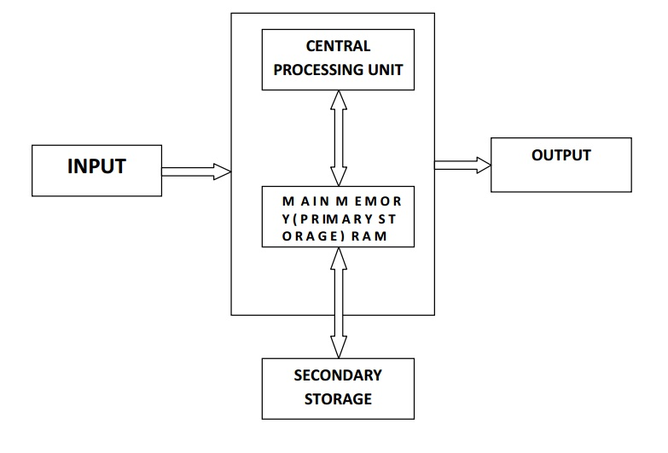

Slide 4
Introduction to CPU
CPU
§ The Arithmetic / Logic Unit (ALU)
§ The Control Unit
§ Main Memory
§ External Memory
§ Input / Output Devices
§ The System Bus

Slide 5
CPU OPERATION
The fundamental operation of most CPUs
- To execute a sequence of stored instructions called a program.
1. The program is represented by a series of numbers that are kept in some kind of computer memory.
2. There are four steps that nearly all CPUs use in their operation: fetch, decode, execute, and write back.
3. Fetch:
o Retrieving an instruction from program memory.
o The location in program memory is determined by a program counter (PC)
o After an instruction is fetched, the PC is incremented by the length of the instruction word in terms of memory units.

Slide 6
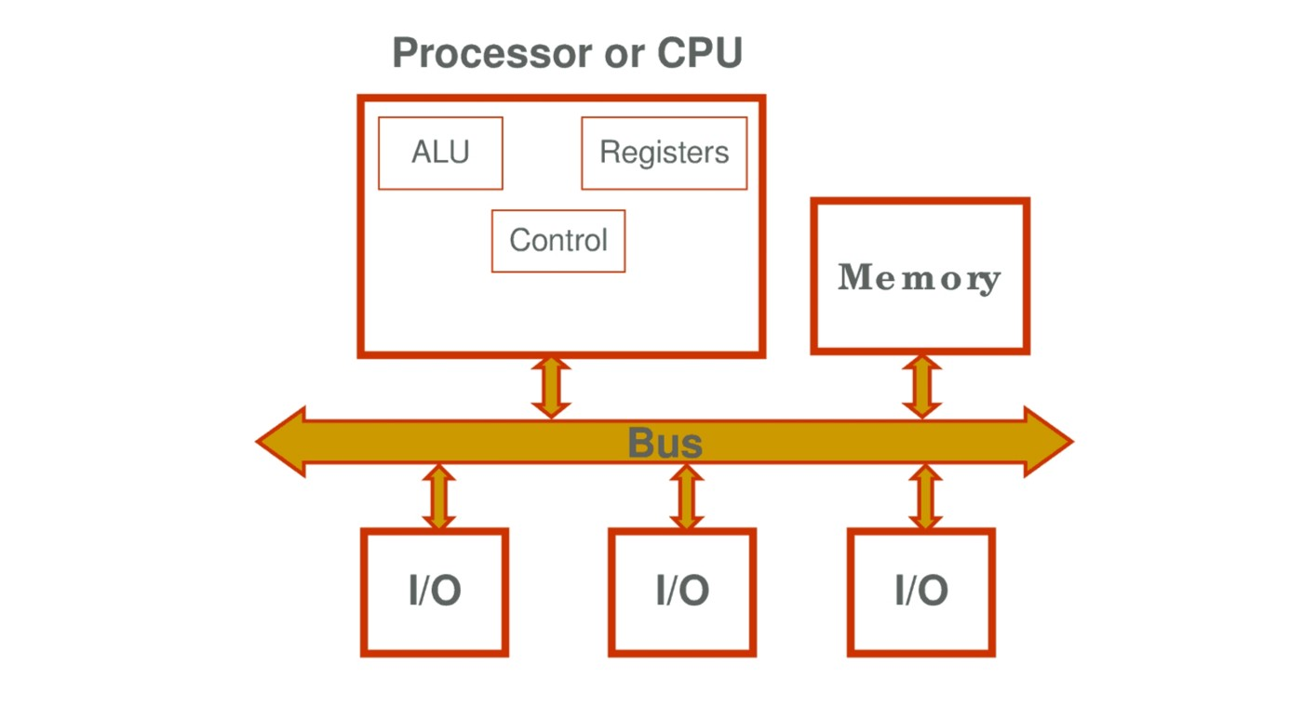
BASIC COMPUTER ORGANIZATION
Process→Output (a certain input is processed to generate specific output).
As per the diagram explained below…..
ARITHMETIC LOGICAL UNIT(ALU) — The ALU perform all four arithmetic function (+,-,*,/) and some logical (<,>,=,<=,>=,!=) operations. When two numbers are required to be added this numbers are sent from memory to ALU where addition takes place and the result is put back in the memory. In the same way, other arithmetic operations are performed through (ALU only).
CONTROL UNIT — The CU controls and guides the interpretation, flow and manipulation of all data and information. The CU sends control signal until the required operation are done properly by ALU and MEMORY. Another important function of CU is program execution i.e., carrying out all the instructions stored in the program. The CU gets program instructions from memory and execute them one after the other. After getting the information from MEMORY in CU, the instructions us decoded and interpreted i.e., which operations is to be perform.
Registers — Registers processor registers are small units of data holding places. The CPU uses the REGISTERS to temporarily hold some important processing-information during the time the processing is taking place
THE MEMORY — The MEMORY of a computer is more like a predefined working place, where it temporarily keeps information and data to facilitate it’s performance. Each MEMORY location has its own unique MEMORY address. When the task is performed, it clear it’s MEMORY and MEMORY space is then available for the next task to be performed. When the power is off, the information stored will erased and unable to recover

